Slide 1
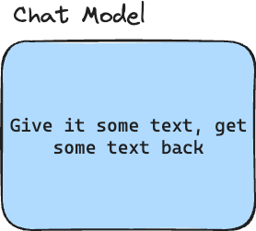

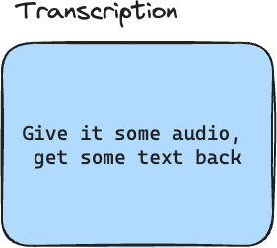
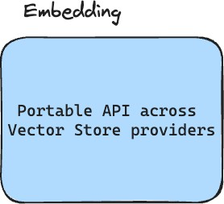
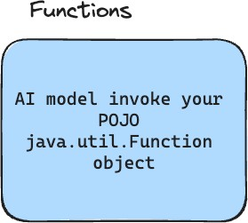
Spring AI API
The Spring AI API covers a wide range of functionalities

Slide 2
Chat Model
Give it some text, get some text back
Open AI
Azure Open AI
Amazon Bedrock
Google Vertex AI Palm
Google Gemeni
HuggingFace - Access to thousands of models, including those from Meta such as Llama 2
Ollama - Run AI Models on your local machine
MistralAI

Slide 3
Text-to-Image Models
Give it some text, get an image back
OpenAI with DALL-E
StabilityAI

Slide 4
Transcription
Give it some audio, get some text back
Open AI

Slide 5
Embedding Models
Portable API across Vector Store providers
Open AI
Azure Open AI
Ollama
ONNX
PostgresML
Bedrock Cohere
Bedrock Titan
Google VertexAI
MistalAI

Slide 6
Getting started

Slide 7
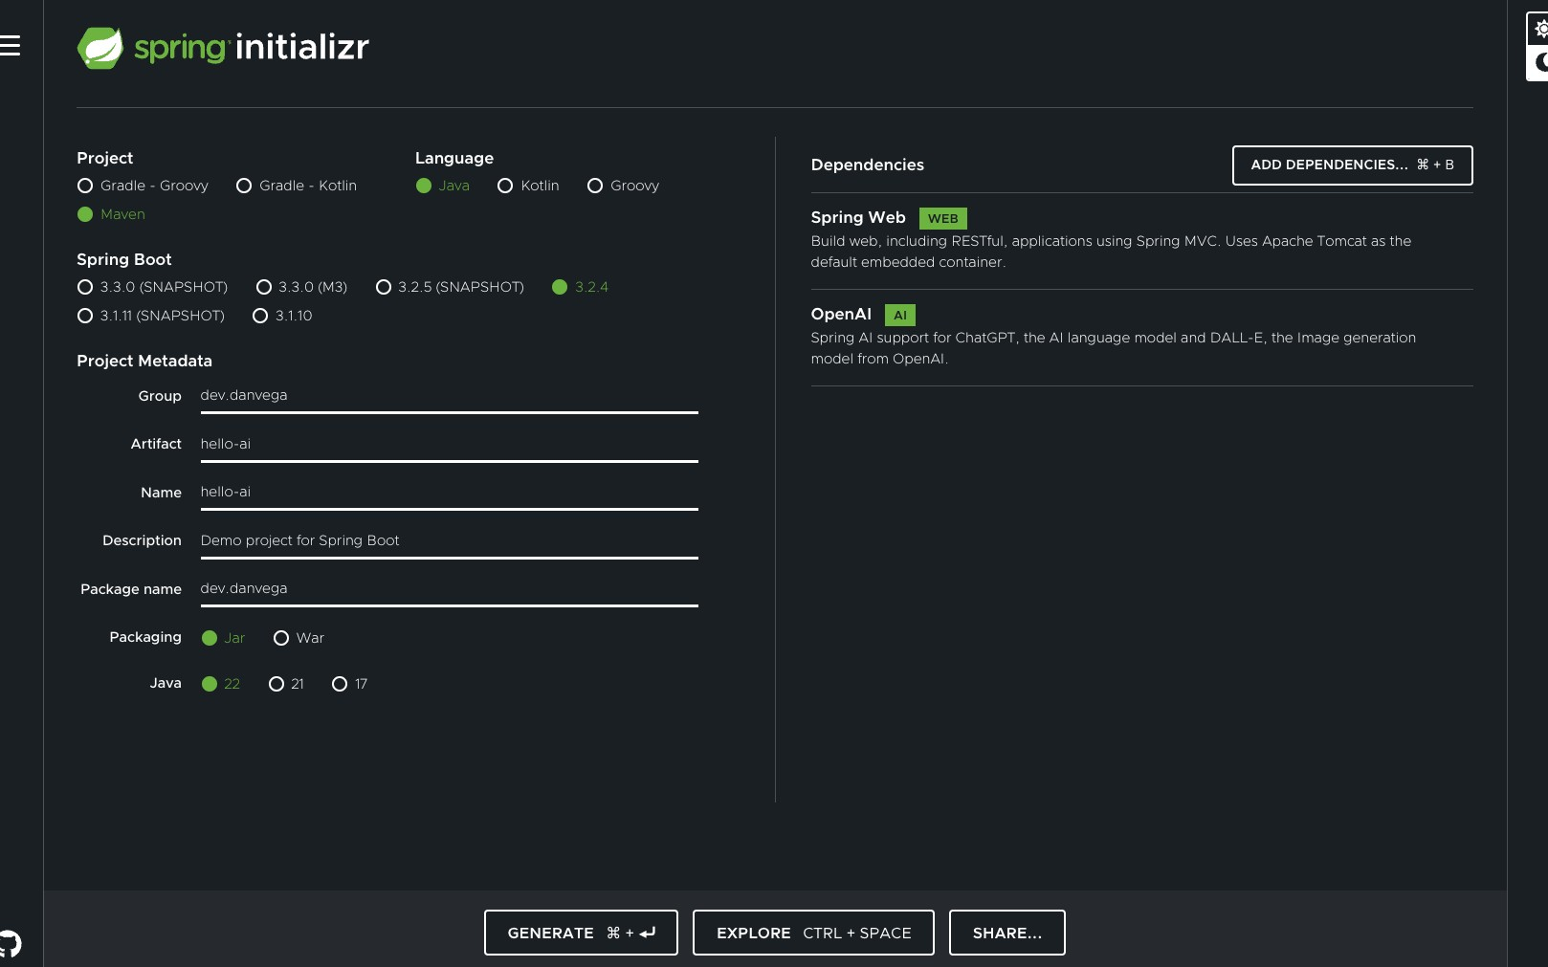

Slide 8


Slide 9
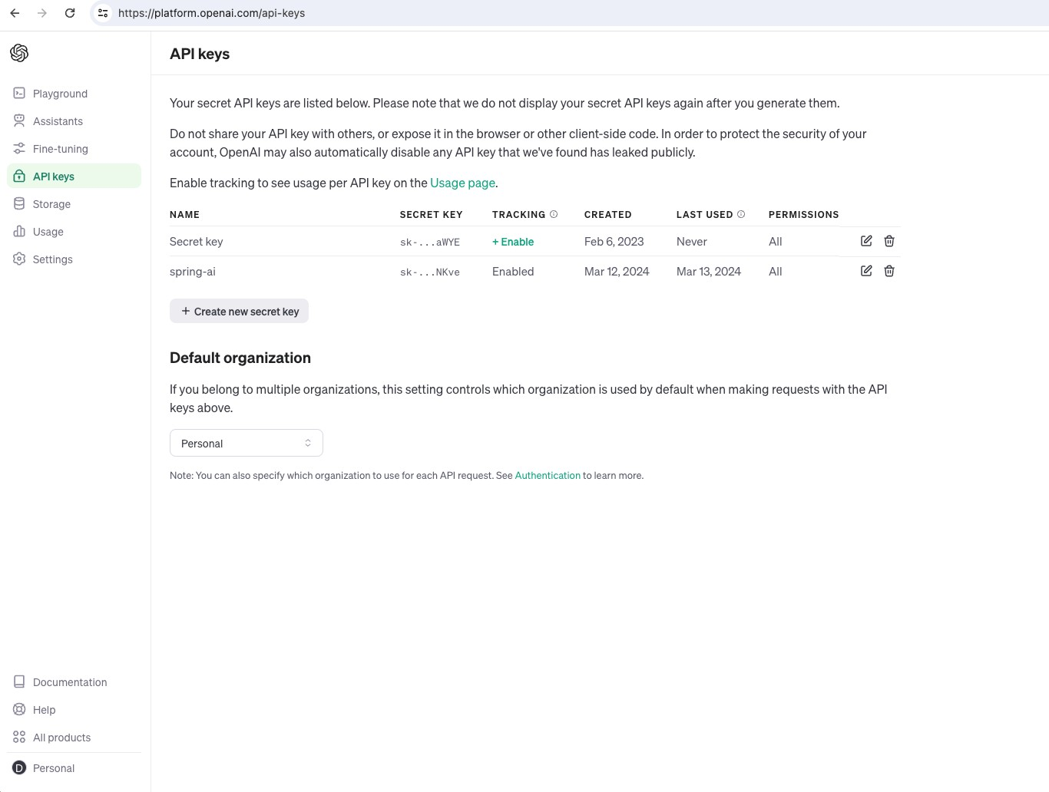

Slide 10
Tokens

Slide 11
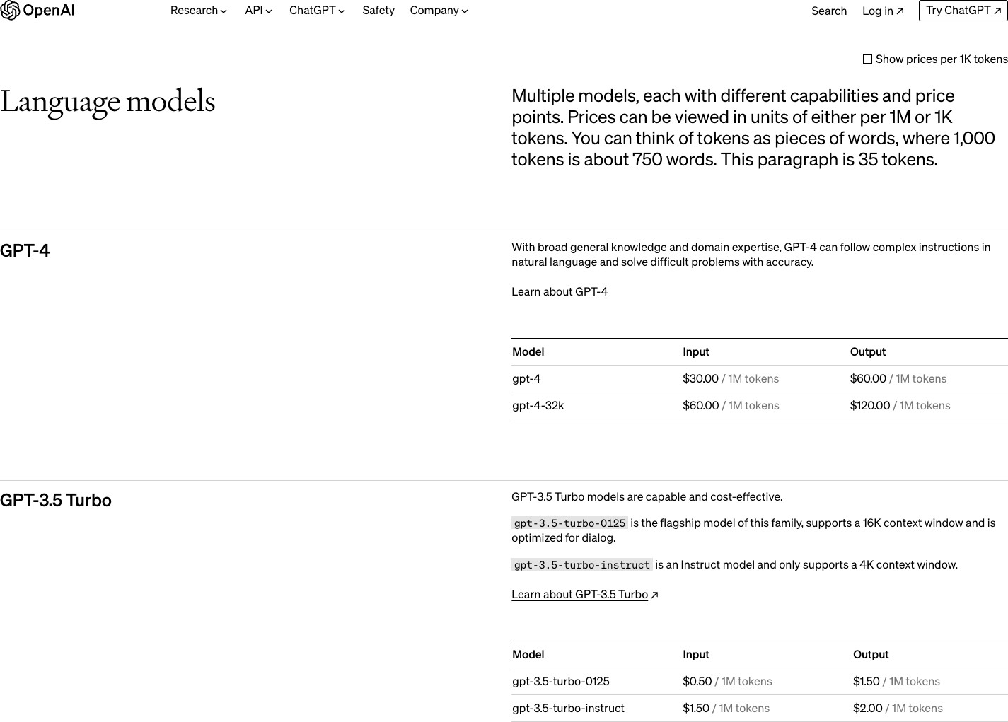

Slide 12
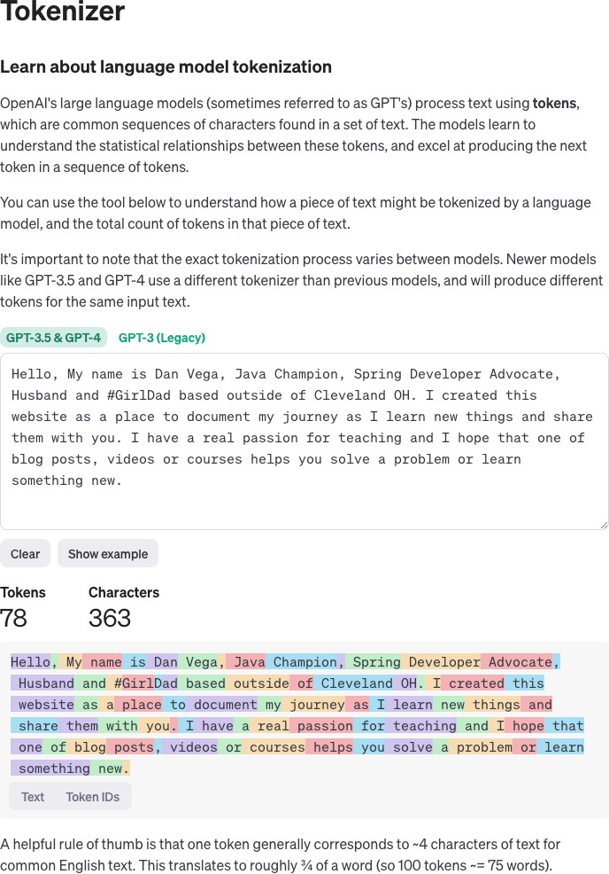
https://platform.openai.com/tokenizer

Slide 13

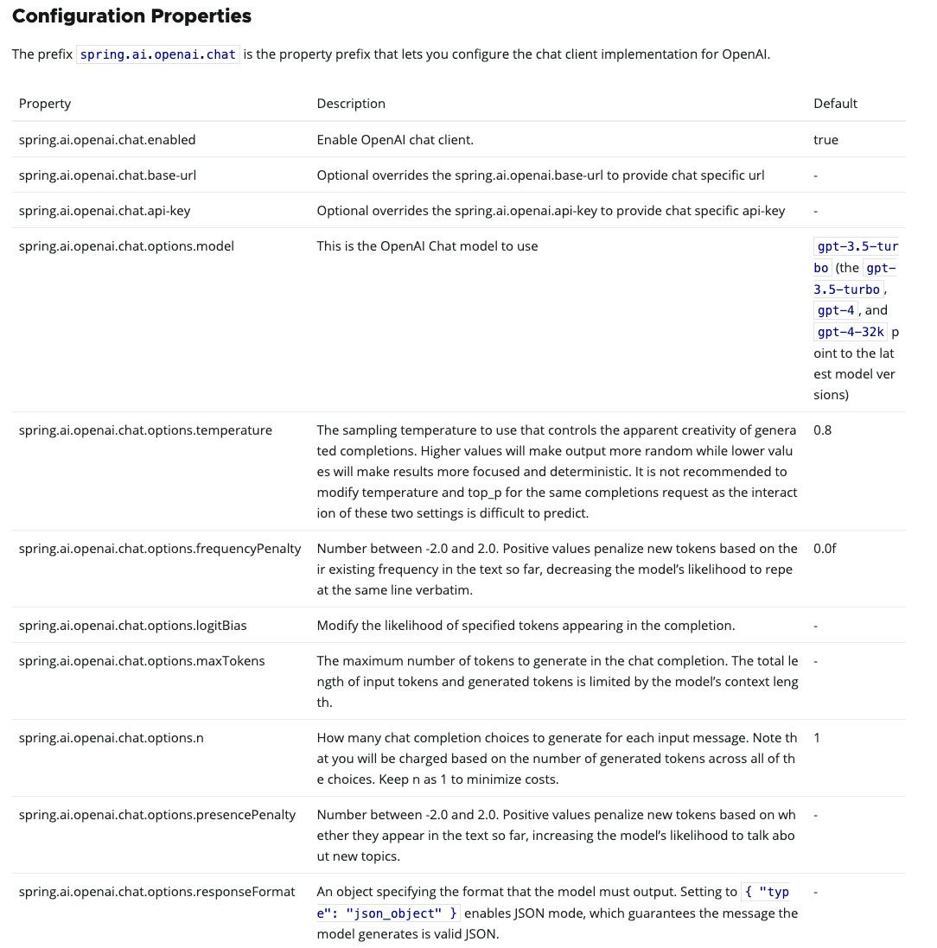
spring.application.name=hello-spring-ai spring.ai.openai.api-key=YOUR_KEY_HERE spring.ai.openai.chat.options.model=gpt-4

Slide 14

Demo - Getting Started

Slide 15
Prompts

Slide 16

Prompts serve as the foundation for the language-based inputs that guide an AI model to produce specific outputs. For those familiar with ChatGPT, a prompt might seem like merely the text entered into a dialog box that is sent to the API. However, it encompasses much more than that. In many AI Models, the text for the prompt is not just a simple string.

Slide 17


Prompt Engineering
Effective Communication
Input directing an AI model to produce specific outputs
Model outputs are greatly inference by prompt style and wording
Prompt Engineering
Prompt techniques and effective prompts are share in the community
OpenAI Guidelines
Mini Course: ChatGPT Prompt Engineering for developers
Prompts and Spring
Prompt management relies on Text Template Engines
Analogous to the view in Spring MVC

Slide 18
public class Prompt implements ModelRequest<List<Message >> { private final List<Message> messages;
private ChatOptions modelOptions;
public Prompt(String contents) { this((Message)(new UserMessage(contents)));
}
public Prompt(Message message) { this(Collections.singletonList(message));
}
public Prompt(List<Message> messages) { this.messages = messages;
}
public Prompt(String contents, ChatOptions modelOptions) { this((Message)(new UserMessage(contents)), modelOptions);
}
public Prompt(Message message, ChatOptions modelOptions) { this(Collections.singletonList(message), modelOptions);
}
public Prompt(List<Message> messages, ChatOptions modelOptions) { this.messages = messages;
this.modelOptions = modelOptions;
}

Slide 19
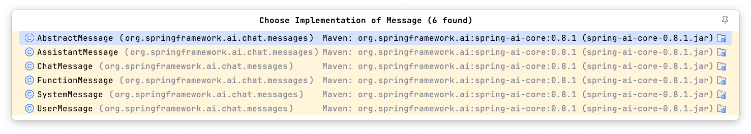
public class Prompt implements ModelRequest<List<Message >> { private final List<Message> messages;
private ChatOptions modelOptions;
public Prompt(String contents) { this((Message)(new UserMessage(contents)));
}
public Prompt(Message message) { this(Collections.singletonList(message));
}
public Prompt(List<Message> messages) { this.messages = messages;
}
public Prompt(String contents, ChatOptions modelOptions) { this((Message)(new UserMessage(contents)), modelOptions);
}
public Prompt(Message message, ChatOptions modelOptions) { this(Collections.singletonList(message), modelOptions);
}
public Prompt(List<Message> messages, ChatOptions modelOptions) { this.messages = messages;
this.modelOptions = modelOptions;
}

Slide 20
Roles
System Role: Guides the AI’s behavior and response style, setting parameters or rules for how the AI interprets and replies to the input. It’s akin to providing instructions to the AI before initiating a conversation.
User Role: Represents the user’s input – their questions, commands, or statements to the AI. This role is fundamental as it forms the basis of the AI’s response.
Assistant Role: The AI’s response to the user’s input. More than just an answer or reaction, it’s crucial for maintaining the flow of the conversation. By tracking the AI’s previous responses (its 'Assistant Role' messages), the system ensures coherent and contextually relevant interactions.
Function Role: This role deals with specific tasks or operations during the conversation. While the System Role sets the AI’s overall behavior, the Function Role focuses on carrying out certain actions or commands the user asks for. It’s like a special feature in the AI, used when needed to perform specific functions such as calculations, fetching data, or other tasks beyond just talking. This role allows the AI to offer practical help in addition to conversational responses.

Slide 21


DEMO - prompts

Slide 22
Structured output

Slide 23
Output Parsing
Challenges with handling the response
The Challenge
Output of Generative LLM is a java.util.String
Even if you ask for JSON, you get a JSON String
ChatGPT wants to chat, not reply in JSON
OpenAI has introduced a new feature to help with this
Spring AI’s OutputParser uses refined prompts to desired results

Slide 24
Structured output api
Challenges with handling the response
The Challenge
Output of Generative LLM is a java.util.String
Even if you ask for JSON, you get a JSON String
ChatGPT wants to chat, not reply in JSON
OpenAI has introduced a new feature to help with this
Spring AI’s OutputParser uses refined prompts to desired results

Slide 25
Structured Output API
Structured Output Converter Interface
public interface StructuredOutputConverter<T> extends Converter<String, T>, FormatProvider {
/**
@deprecated Use the {@link #convert(Object)} instead.
*/
default T parse(@NonNull String source) { return this.convert(source);
}
}
public interface FormatProvider {
/**
@return Returns a string containing instructions for how the output of a language
generative should be formatted.
*/
String getFormat();
}

Slide 26
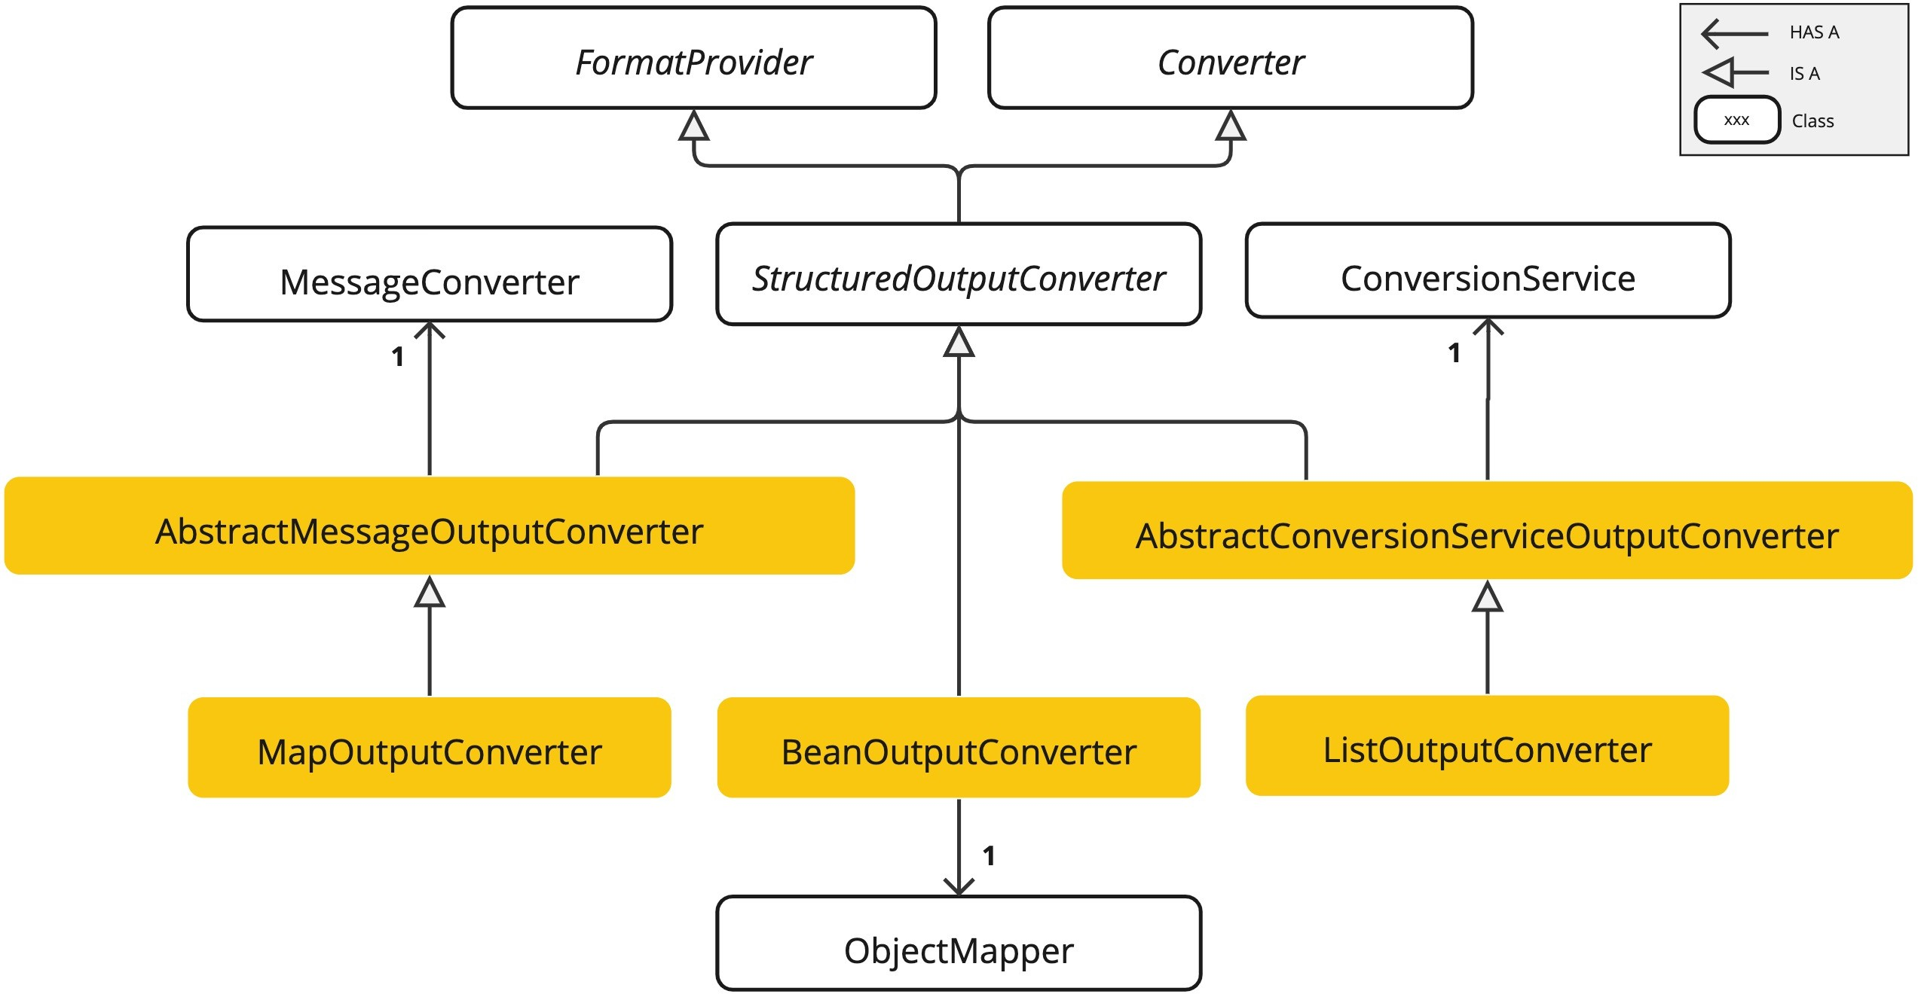
Structured Output API
Available Converters

Slide 27

DEMO - OUtput Parser

Slide 28
Bring your own data

Slide 29

Bring your own data
How to use your own data in AI Applications
AI Models have limitations
They are trained with public knowledge up to a certain date.
They don’t know about your private / corporate data.
What can we do about this problem?
Fine Tune the Model
“Stuff the prompt” - add your data into the prompt
Function Calling
Retrieval Augmented Generation (RAG)
How to retrieve the relevant data for the user input and add it to your prompt
There are many strategies

Slide 30
Stuffing the prompt

Slide 31
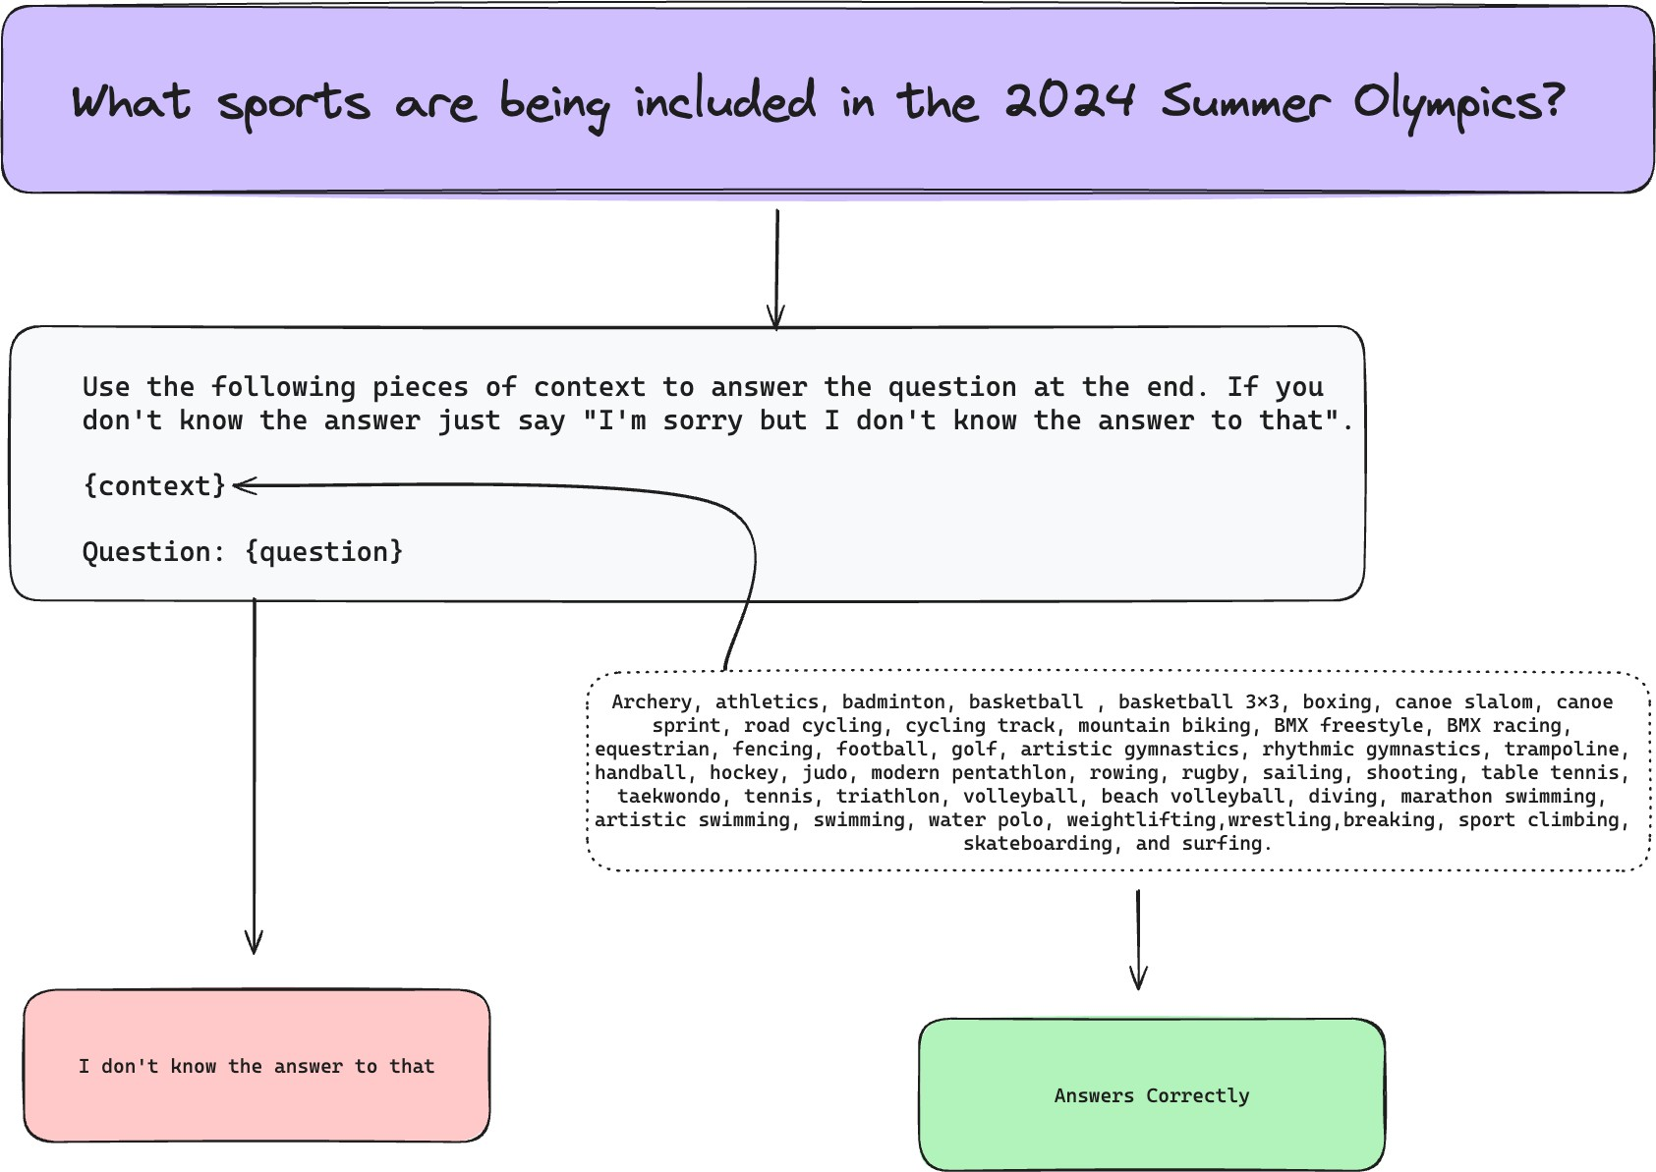

Slide 32
Rag (retrieval Augmented Generation)

Slide 33
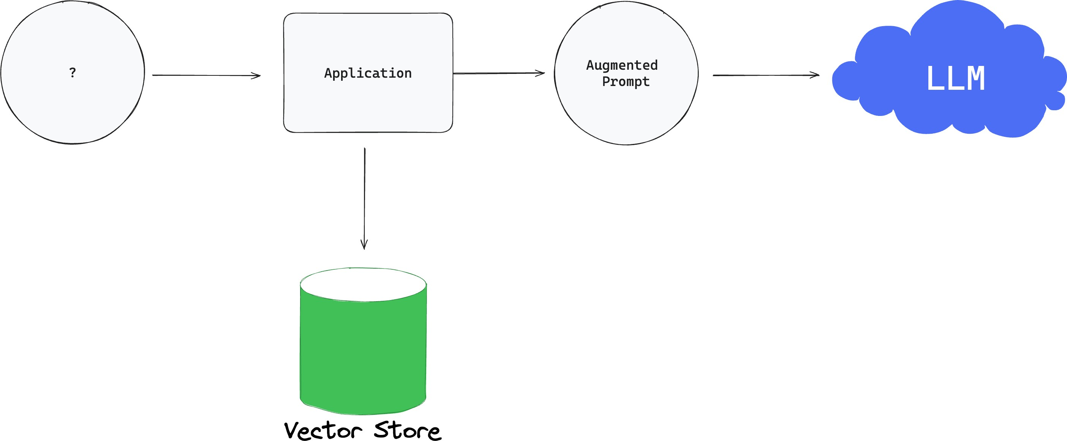
AI Application Architecture - RAG

Slide 34
Vector Stores
Not just for text search
Azure Vector Search
ChromaVectorStore
MilvusVectorStore
Neo4JVectorStore
PgVectorStore
QdrantVectorStore
RedisVectorStore
WeaviateVecvtorStore
SimpleVectorStore

Slide 35
Function calling

Slide 36
Function Calling
Registering Custom Functions
You can register custom Java functions with
the OpenAiChatClient and have the OpenAI model intelligently choose to output a JSON object containing arguments to call one or many of the registered functions.
The OpenAI API does not call the function directly; instead, the model generates JSON that you can use to call the function in your code and return the result back to the model to complete the conversation.

Slide 37
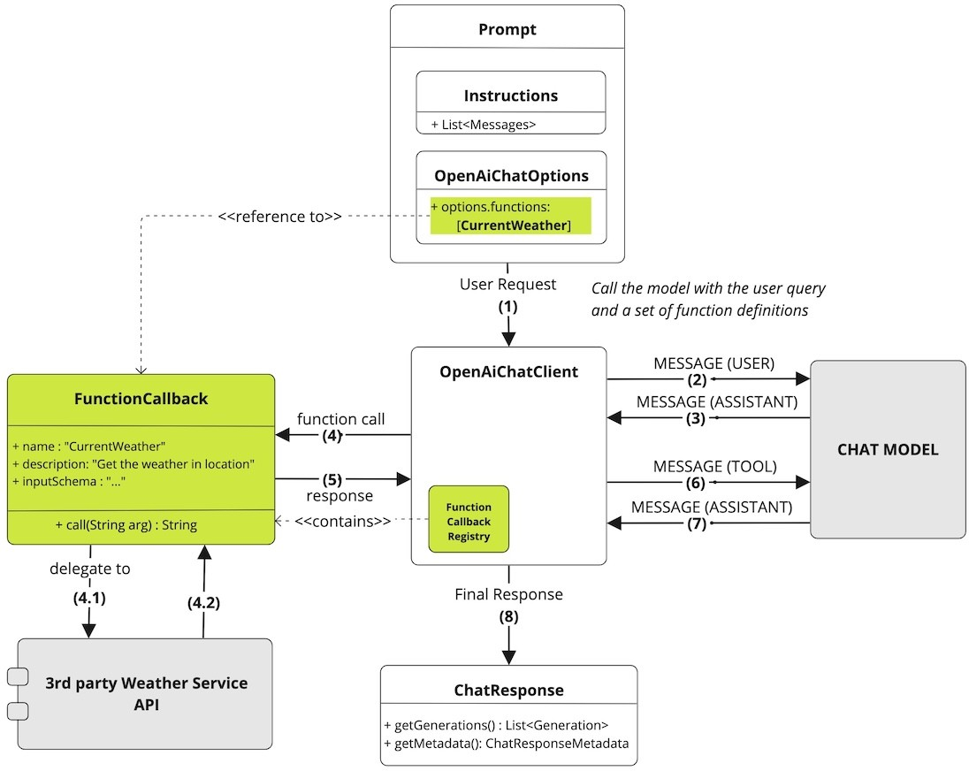

Slide 38

DEMO - your own data

Slide 39
Chat memory

Slide 40
The web is stateless

Slide 41
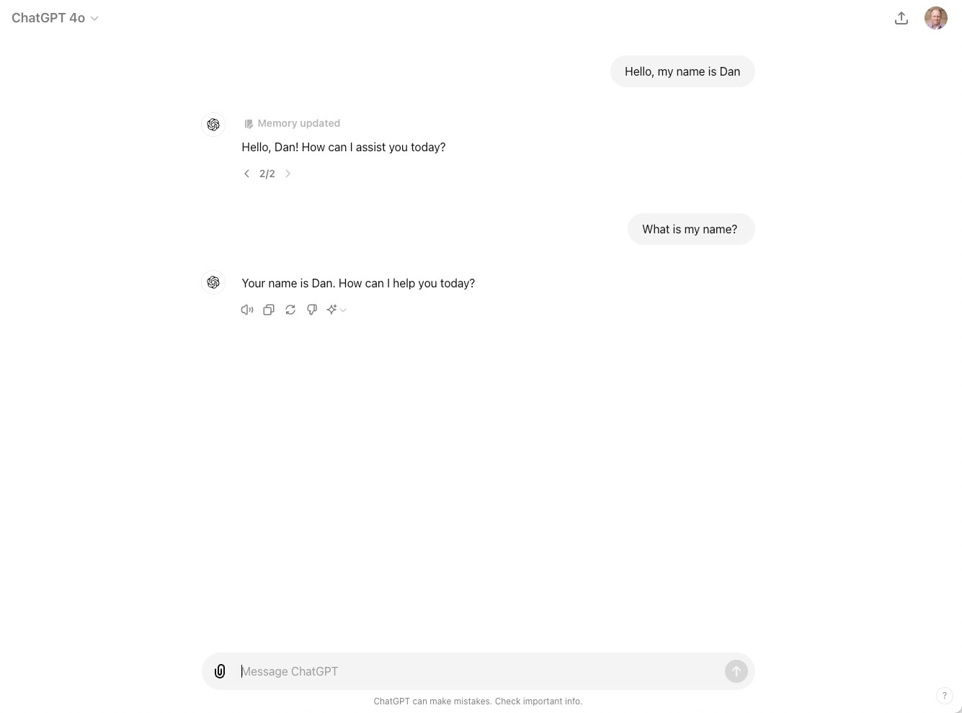

Slide 42
DEMO - chat memory

Slide 43

References
Links & Citations
Spring AI Reference Documentation
https://docs.spring.io/spring-ai/reference/
Google Course
https://www.cloudskillsboost.google/course_templates/536
Spring Team
Mark Pollack
Christian Tzolov
Craig Walls
Josh Long

Slide 44
Thank You
dan.vega@broadcom.com @therealdanvega https://www.danvega.dev

